Slide 1
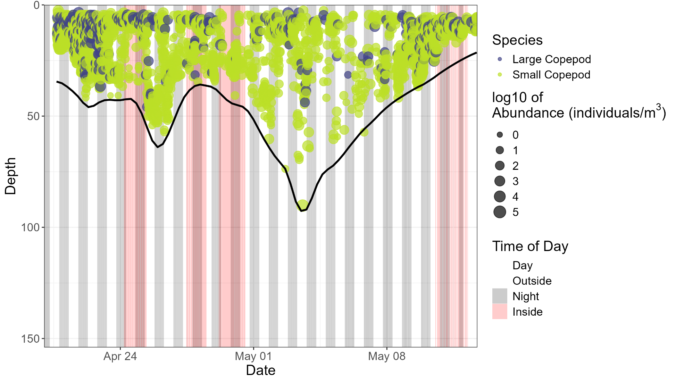
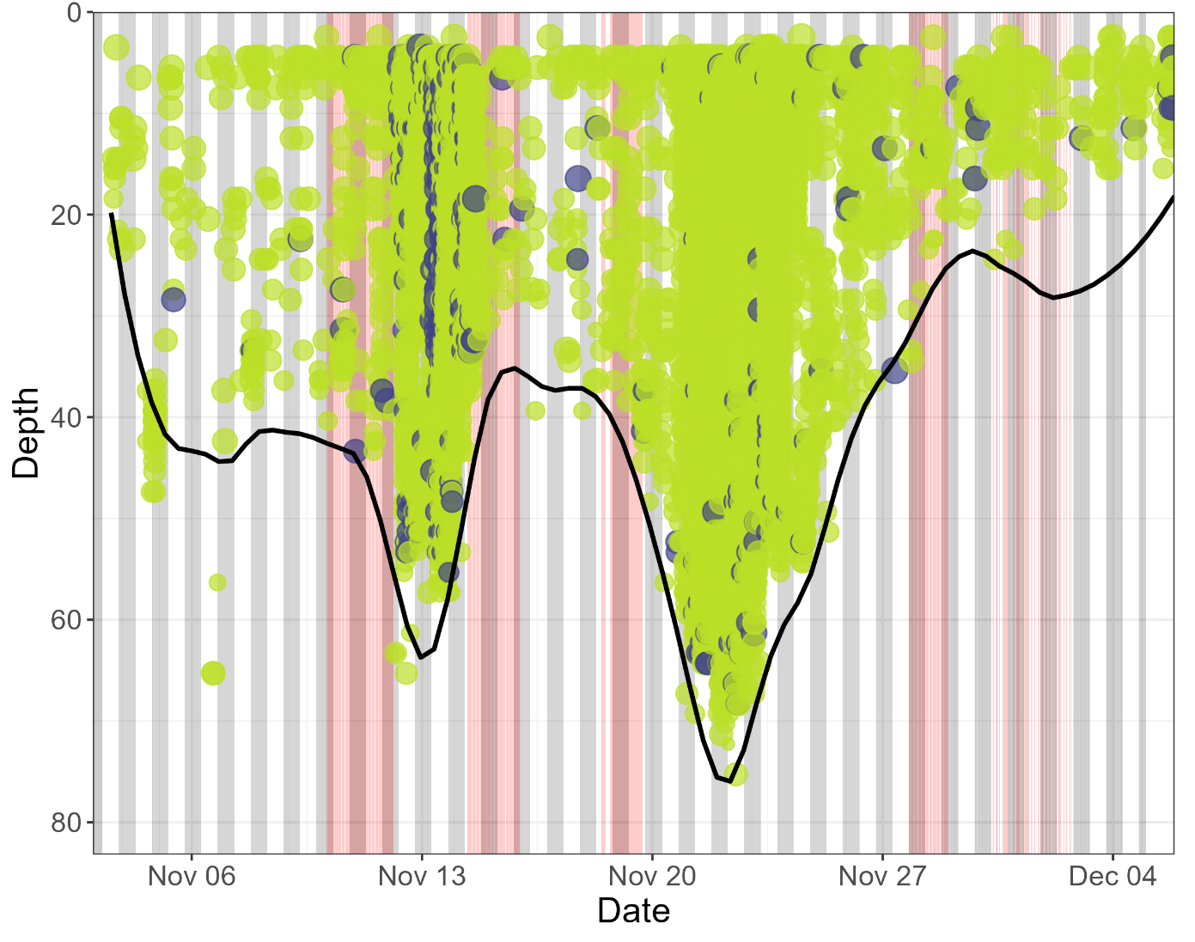
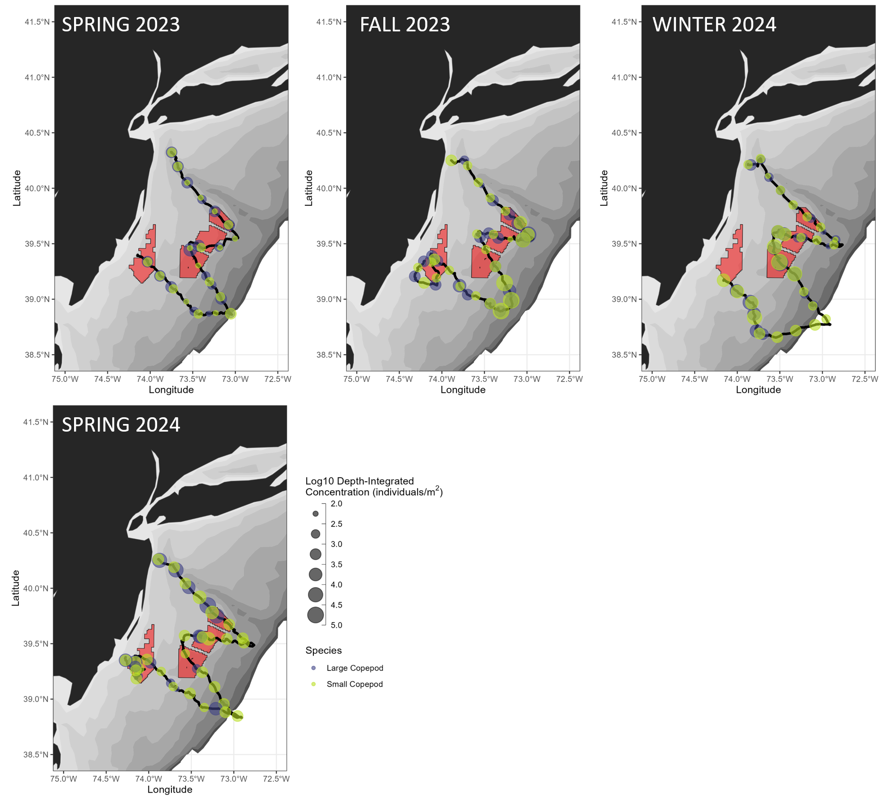
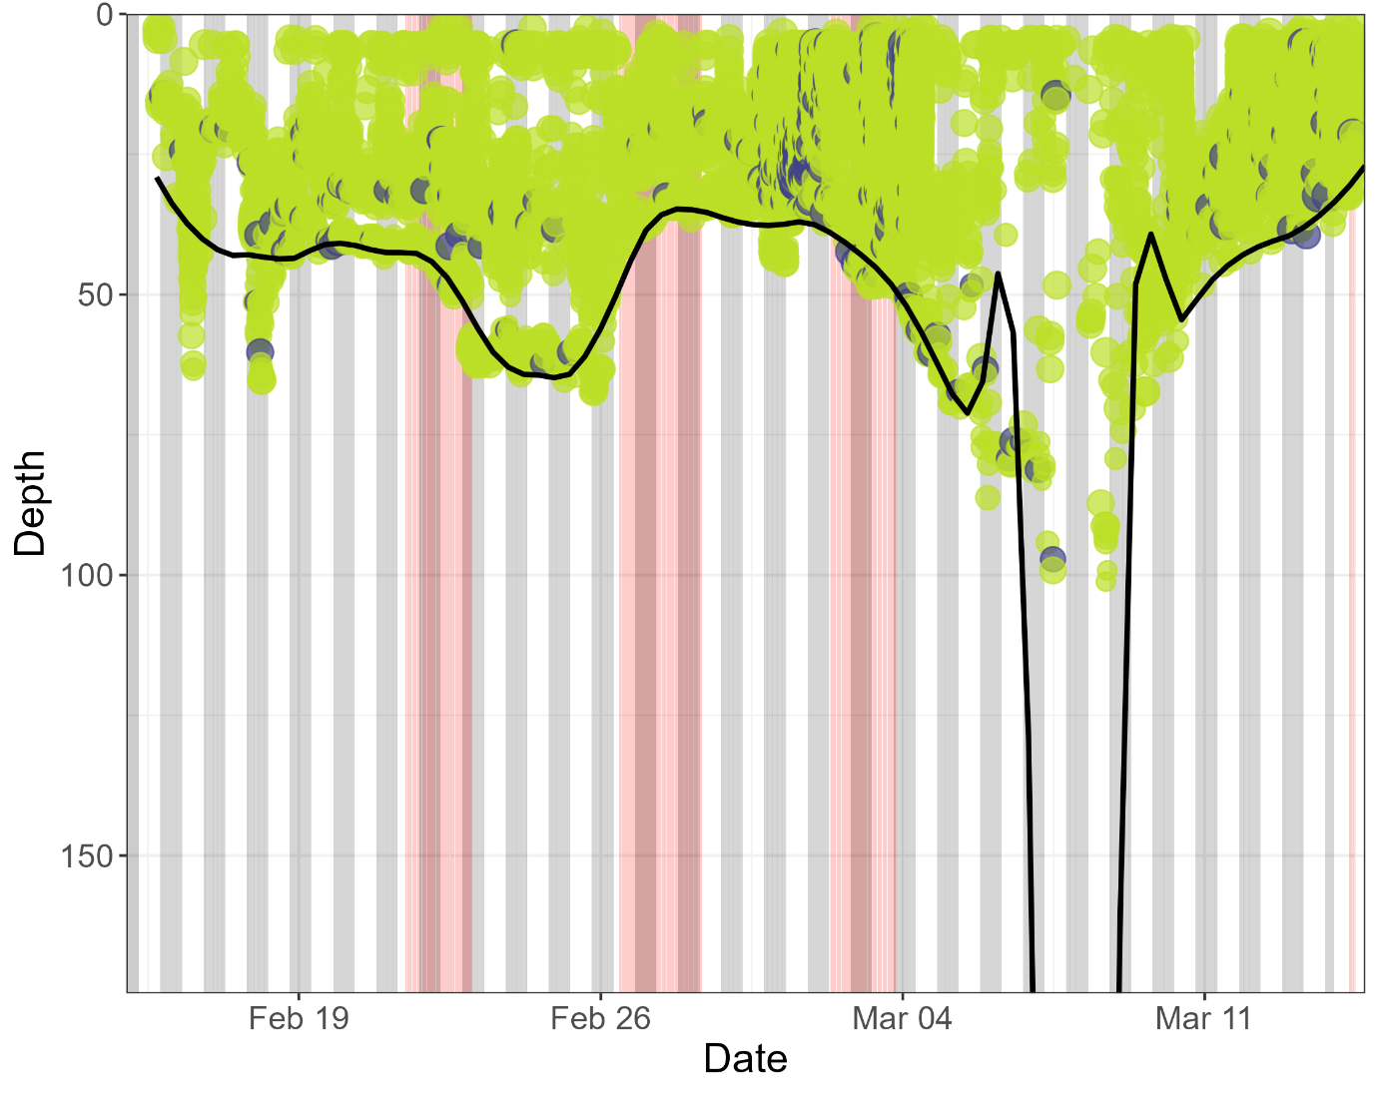
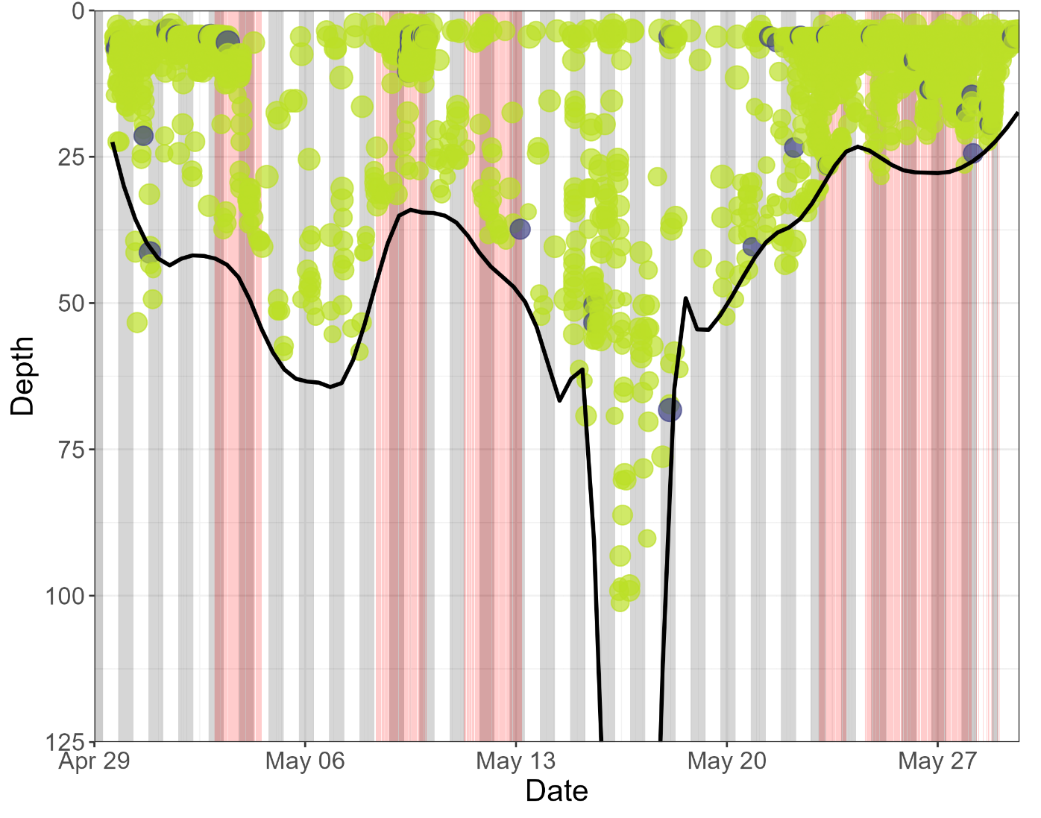
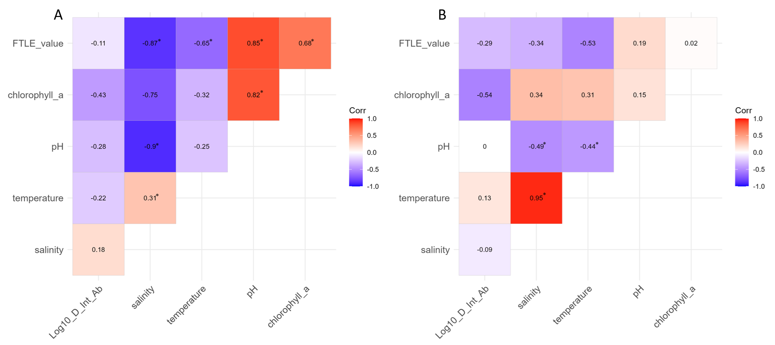
Examining the Seasonal Relationships Between Oceanographic Variables and Echosounder-Derived Zooplankton Abundance Estimates Using an Autonomous Underwater Glider
Delphine Mossman, Josh Kohut, Jacquelyn Veatch, Grace Saba
Center for Ocean Observing Leadership (COOL), Department of Marine and Coastal Sciences, Rutgers University
INTRODUCTION
PRELIMINARY RESULTS
Zooplankton in the Mid-Atlantic Bight (MAB) play a key role in the coastal marine food web.
Their patchiness makes them challenging to measure³⁻⁴, and therefore their seasonal abundance and distribution are not well understood.
Likely Paracalanus spp.
SPRING 2023
FALL 2023
C. finmarchicus
Vertical profiles of small and large copepod concentration over all four seasons analyzed. Each bubble represents the average concentration in an analysis cell 1 m in depth and 0.1 nau. mi. in length.
Depth-integrated concentration of small and large copepods over all four seasons analyzed. Red shapes indicate wind farm lease areas, and each bubble is the averaged depth-integrated concentration over 20 km of glider track.
WINTER 2024
SPRING 2024
OBJECTIVE
Determine seasonal zooplankton abundance and distributions in the Mid-Atlantic Bight (MAB) using a glider-mounted echosounder³⁻⁵, and identify drivers of those patterns
Zooplankton
Small copepods dominated numerical concentration, but large copepods dominated biomass
Patches of dense large copepod aggregations observed along 50m isobath or greater along basin slopes, particularly in fall and winter
CONCLUSIONS
v
v
Gliders provide high-resolution data across time and space in the MAB from which to observe seasonal patterns of zooplankton abundance and distribution.
Oceanographic variables alone do not sufficiently explain zooplankton distribution; interactions between variables should be considered as well as depth-stratified and day/night patterns.
These data serve as a baseline to determine potential future impacts of offshore wind development on zooplankton distributions.
Efforts to determine relationships between zooplankton abundance and whale presence would be informative.
MATERIALS & METHODS
Glider
Deployed a Slocum glider equipped with a 4-frequency Acoustic Zooplankton Fish Profiler (AZFP; 120, 200, 455, 769 kHz) in Spring & Fall 2023, Winter & Spring 2024
dB differencing to classify echoes and determine taxa
Temperature, salinity, pH, and chlorophyll-a measured
Finite Time Lyapunov Exponent (FTLE)
Calculated FTLEs using HF radar data for each day during glider deployment over entire study area
“Strong” FTLE values defined as those in 90th percentile
Correlations
Used GLMs and AIC stepping to test for strength of correlations between copepod concentrations and temperature, salinity, pH, chlorophyll-a, and strong FTLE values (reported here for fall and winter only)
FALL 2023
WINTER 2024
REFERENCES
Correlation matrices examining the correlations between listed variables in the two deployment seasons with greater zooplankton patchiness observed. Displayed values are calculated Pearson correlation coefficient values, and an asterisk means the correlation was significant (p < 0.05).
1. Kane, J. 2011. J. Northw. Atl. Fish. Sci., Vol. 43: 81–92. 2. Floeter, J., et al. 2017. Prog. Oceanogr. 156:154:173. 3. Benoit‐Bird, K.J., et al. 2018. Limnol. Oceanogr.: Methods 16 (11): 734–49. 4. Ohman, M.D., et al. 2019. Limnol. Oceanogr.: Methods 17: 69–86. 5. Whitmore et al. 2019. J. Plankton Res. 41(4):521-533.
Linear Model Correlations
No significant linear correlations between log10 depth-integrated large copepod concentrations and any oceanographic variables
Multivariate Correlations
Fall 2023 had salinity, temperature, chlorophyll-a, pH, and FTLE identified as best parameters for predicting log10 of depth-integrated abundance of large copepods, but p > 0.05
Winter 2024 had salinity, temperature, chlorophyll-a, and FTLE identified as best parameters for predicting log10 of depth-integrated abundance of large copepods, R² of 0.65 (p < 0.05)
ACKNOWLEDGEMENTS
Thank you to members of the Saba lab, the RUCOOL glider team, and the HF radar team. Special thanks to the many boat captains and mates who made sampling and glider deployments and recoveries possible. Support of this work was provided by a grant from the New Jersey Research and Monitoring Initiative.

